Slide 1
Binary SearchTrees
[CLRS] – Chap 12

Slide 2
Context and Problem
We need a dynamic set where all operations are equally important: insert, delete, search, maximum, minimum, ordered list
This is a kind of dynamic set that generalizes both the Dictionary structure as well as the Priority Queue structure
Binary Search Trees are such a data structure

Slide 3
What is a binary tree ?
A binary tree is a linked data structure in which each node is an object that contains following attributes:
  a key and satellite data
  left, pointing to its left child
  right, pointing to its right child
  p, pointing to its parent
If a child or the parent is missing, the appropriate attribute contains the value NIL.
A binary tree is a recursive structure
Particular kinds of nodes:
  Root
  Leaves
Height of a tree: longest path from the root to one of the leaves; max(heights of subtrees) + 1

Slide 4
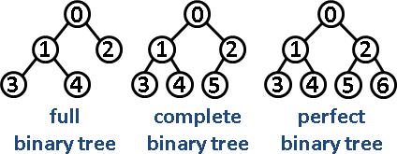
Shapes of binary trees
A full binary tree is a binary tree in which every node other than the leaves has two children.
A complete binary tree is a binary tree in which every level, except possibly the last, is completely filled, and all nodes are as far left as possible.
A perfect binary tree is a binary tree in which all interior nodes have two children and all leaves have the same level.
Degenerated tree – if every node has only 1 child, the tree is like a list

Slide 5
Kinds of binary trees
General binary tree: no conditions regarding key values and shape
Min-heap tree: is a binary tree such that:
  the key contained in each node is less than (or equal to) the key in that node’s children.
  the binary tree is complete
Max-heap tree: is a binary tree such that:
  the key contained in each node is bigger than (or equal to) the key in that node’s children.
  the binary tree is complete
Binary search tree

Slide 6
What is a Binary Search Tree
(BST)
The keys in a binary search tree are always stored in such a way as to satisfy the binary-search-tree property:
  Let x be any node in a binary search tree. If y is any node in the left subtree of x, then y.key <=x.key. If y is any node in the right subtree of x, then y.key >= x.key.
X
<=X
>=X

Slide 7
Example – BST
10
4
15
1
6
20
2
5
8
18
23

Slide 8
Counterexample – NOT a BST !
10
1
15
2
4
18
5
6
8
20
23

Slide 9
What can be done on a BST ?
Tree walks
  List in order
Queries
  Search
  Minimum
  Maximum
  Successor
  Predecessor
Modifying
  Insert
  Delete
These are
Dynamic-set operations
BST generalize both the
Dictionary structure as well
as the Priority Queue structure

Slide 10
Example – List in order
10
4
15
1
6
20
2
5
8
18
23
List in order: 1 2 4 5 6 8 10 15 18 20 23

Slide 11
Tree walks
The binary-search-tree property allows us to print out all the keys in a binary search tree in sorted order by a simple recursive algorithm, called an inorder tree walk.
This algorithm is so named because it prints the key of the root in between printing the values in its left subtree and printing those in its right subtree.
Postorder: print subtrees, after this print root
Preorder: print root first and then print subtrees

Slide 12
Example – Tree walks
10
4
15
1
6
20
2
5
8
18
23
Inorder: 1 2 4 5 6 8 10 15 18 20 23
Postorder: 2 1 5 8 6 4 18 23 20 15 10
Preorder: 10 4 1 2 6 5 8 15 20 18 23

Slide 13
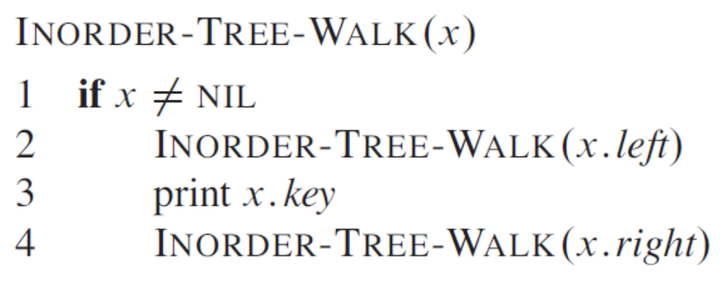
Inorder
[CLRS, chap 12, pag 288]

Slide 14
Complexity of tree walks
We have a BST with n nodes
Intuitively: every node is visited exactly once and a constant time operation (print) is done on it => O(n)
Formal:
Suppose that the BST with n nodes has k nodes in the left subtree and n-k-1 in the right subtree
T(n)=c, if n=0
T(n)=T(k)+T(n-k-1)+d, if n>0
We assume that T(n)=(c+d)*n+c => easy proof by induction (verify basecase for n=0, assume true for all smaller than n, replace in T(n) and prove that it is according to the assumed formula)

Slide 15
Querying a binary search tree
Search
Minimum
Maximum
Successor
Predecessor

Slide 16
Example – Search
6<10
left
Search for k=6,
return pointer x to node
containing k
10
6>4
4
15
right
1
6
20
2
5
8
18
23

Slide 17
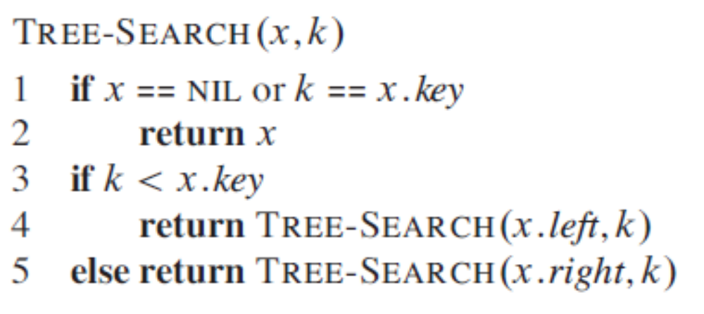
Search – recursive version
[CLRS, chap 12, pag 290]

Slide 18
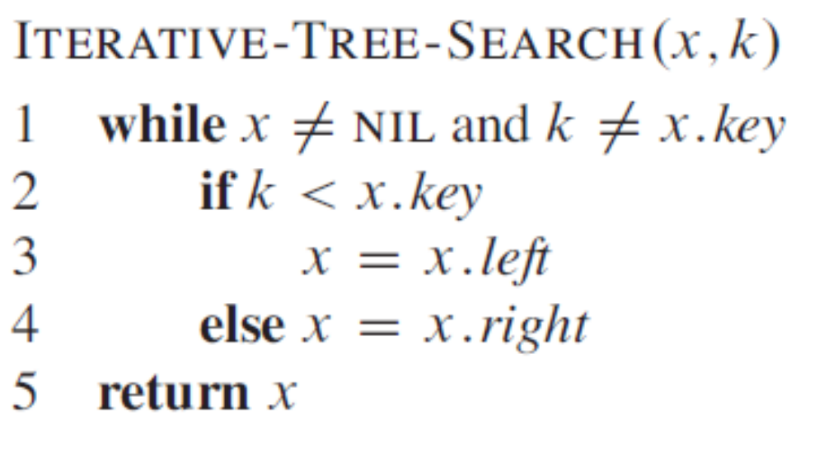
Search – iterative version
[CLRS, chap 12, pag 291]

Slide 19
Example – Minimum and Maximum
Search nodes with
minimum and
maximum key values
left
10
right
left
4
15
right
1
6
20
right
2
5
8
18
23

Slide 20
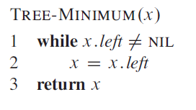
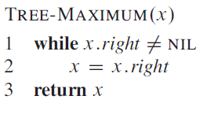
[CLRS, chap 12, pag 291]

Slide 21
Example – Successor
Find the node y which
contains the successor of
a given node x
10
x
4
15
1
6
20
2
5
8
18
23
Successor of x = the smallest key which is bigger than x.key
Case 1: x has a right subtree :
the successor y is the minimum in the right subtree

Slide 22
Example – Successor
10
Find the node y which
contains the successor of
a given node x
y
4
15
1
6
20
2
5
8
18
23
x
3
Successor of x = the smallest key which is bigger than x.key
Case 2: x has no right subtree

Slide 23
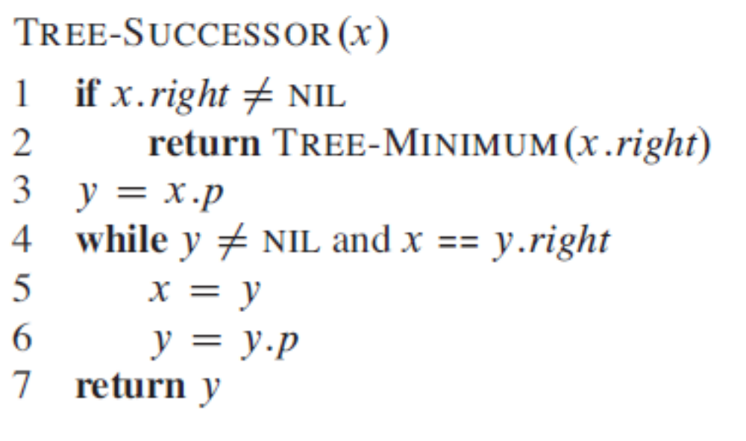
Case1
Case2
[CLRS, chap 12, pag 292]

Slide 24
Modifying a binary search tree
The operations of insertion and deletion cause the dynamic set represented by a binary search tree to change.
The data structure must be modified to reflect this change, but in such a way that the binary-search-tree property continues to hold !

Slide 25
Operation: Insert
Insert a node z into a binary search tree T
After insertion, T must remain a binary search tree

Slide 26
Example – Insert
y
x
Insert node z
z.key=7
Step 1
10
4
7<10
15
1
6
20
2
5
8
18
23
z
7

Slide 27
Example – Insert
y
Insert node z
z.key=7
Step 2
10
x
4
15
7>4
1
6
20
2
5
8
18
23
z
7

Slide 28
Example – Insert
Insert node z
z.key=7
Step 3
10
y
4
15
1
6
20
x
7>6
2
5
8
18
23
z
7

Slide 29
Example – Insert
Insert node z
z.key=7
Step 4
10
4
15
1
6
20
y
x
2
5
8
18
23
z
7<8
7

Slide 30
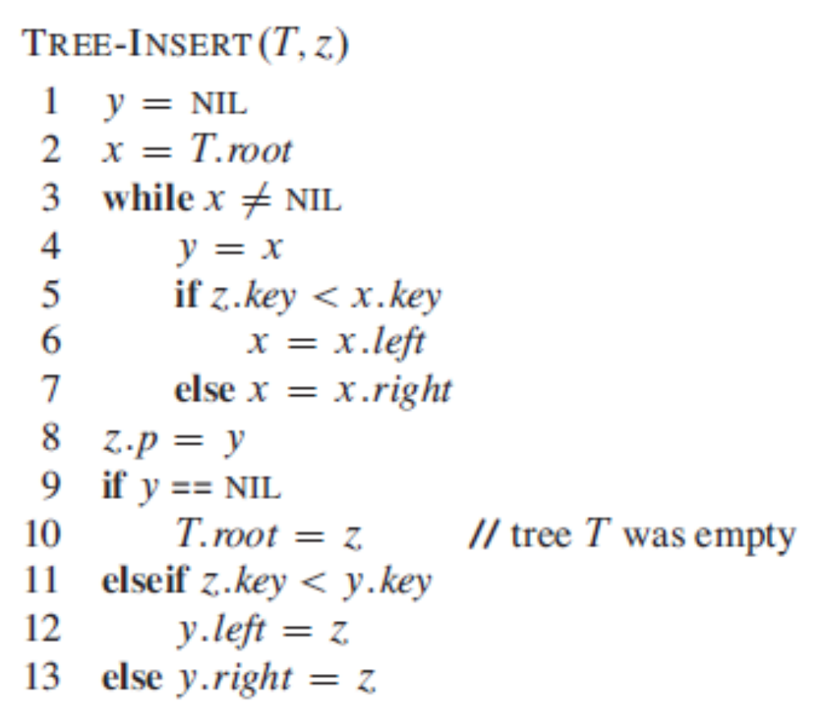
[CLRS, chap 12, pag 294]

Slide 31
Operation: Delete
Delete a node z from a binary search tree T
After delete, T must remain a binary search tree
  Important requirement for a good delete algorithm: do a minimum number of tree link reassignments!
Cases:
  Cases 1+2: node z has only 1 child -> the only child takes the place of its deleted parent z
  Case 3+4: node z has 2 children. The successor of z will take its place

Slide 32
Example - delete
z
10
10
4
15
6
15
6
13
20
13
20
Delete z. Case 1: z has no left child

Slide 33
Example - delete
z
10
10
4
15
2
15
2
13
20
13
20
Delete z. Case 2: z has no right child

Slide 34
Example - delete
z
10
10
4
15
6
15
y
2
6
13
20
2
8
13
20
1
3
8
1
3
Delete z. Case 3: z has 2 children and
z’s successor, y, is the right child of z

Slide 35
Example - delete
z
10
10
4
15
5
15
y
6
6
2
13
20
2
13
20
1
2.5
5
8
1
5.5
8
2.5
5.5
Delete z. Case 4: z has 2 children and
z’s successor, y, is not the right child of z

Slide 36
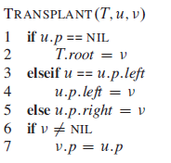
BST delete – shaping the general solution
Suppose that in order to move subtrees around within the BST, we deﬁne the operation TRANSPLANT, which replaces one subtree u as a child of its parent with another subtree v.
[CLRS, chap 12, pag 296]

Slide 37
Tree delete – case 1
T
T
z
z.right
If (z.left==nil)
Transplant(T, z, z.right)

Slide 38
Tree delete – case 2
T
T
z
z.left
If (z.right==nil)
Transplant(T, z, z.left)

Slide 39
Tree delete – case 3
T
T
If (z.left<>nil and z.right<>nil)
Y=TREE-MINIMUM(z.right)
If (y=z.right)
TRANSPLANT(T,z,y)
y.left=z.left
y.left.p=y
z
y

Slide 40
Tree delete – case 4
T
T
z
If (z.left<>nil and z.right<>nil)
Y=TREE-MINIMUM(z.right)
If (y<>z.right)
TRANSPLANT(T,y,y.right)
y.right=z.right
y.right.p=y
TRANSPLANT(T,z,y)
y.left=z.left
y.left.p=y
y

Slide 41
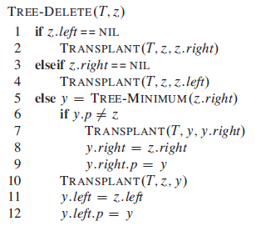
Tree-Delete
Case1
Case 2
Case 4
Case3
[CLRS, chap 12, pag 298]

Slide 42
BST Delete
The previous implementation of BST Delete considered replacing the deleted node z with its successor
Another similar solution is to replace the deleted node z with its predecessor

Slide 43
Exercise
Draw the Binary Search Tree that results from following sequence of operations:
Insert 29, 37, 1, 3, 7, 20, 89, 75, 4, 2, 6, 30, 35
Delete 3, 29, 37

Slide 44
Analysis
Tree walks Θ(n)
Queries
  Search O(h)
  Minimum O(h)
  Maximum O(h)
  Successor O(h)
  Predecessor O(h)
Modifying
  Insert O(h)
  Delete O(h)
n = number of nodes in BST
h = height of BST

Slide 45
The Height of Binary Search Trees
Each of the basic operations on a binary search tree runs in O(h) time, where h is the height of the tree => It is desirable that h is small
The shape and height of a binary search tree of n nodes depends on the order in which the keys are inserted (insert in order: 1,2,3 vs insert in order 2,1,3)
The height of a BST with n nodes:
  Worst case: O(n) => BST operations are also O(n) !!!
  Best case: O(log n)
  Average case O(log n)

Slide 46
Height of a BST – worst case
If the n keys are inserted in strictly increasing order, the tree will be a chain with height n-1.
1
2
3
4
5

Slide 47
Height of a BST – best case
The best case corresponds to a balanced tree
In this case the height is log n
1
2
3
4
5
6
7
4
2
6
1
3
5
7

Slide 48
Height of a BST – random case
It can be proved that: The expected height of a randomly built binary search tree on n distinct keys is O (lg n)

Slide 49
Keeping the height of BST small
Different techniques are used in order to keep the height of BST small – after an insertion or deletion some operations are done in order to redo the balance:
  AVL trees (Adelson-Velskii and Landis)
  Red-black trees (symmetric binary B-trees, 2-3 trees)

